Slide 1
DESIGN AND IMPLEMENTATION OF SWB ANTENNA FOR 5G
GUIDED BY : PRESENTED BY :
Ms.A.Rosariyo,M.E.,(AP/ECE) G.karthik -921619106028
M.Murali -921619106039
R.Samuel Ebinezer -921619106048
R.Sathees -921619106054

Slide 2
Domain-SWB Antenna
An SWB Antenna is a transducer, which converts electrical power into electromagnetic waves and vice versa.
An SWB Antenna can be used either as a transmitting antenna or a receiving antenna.
A transmitting SWB antenna is one, which converts electrical signals into electromagnetic waves and radiates them.

Slide 3
Abstract
This work investigates the design and practical implementation of a Super Wide Band (SWB) antenna on a flexible substrate.
This antenna has an operating frequency band from 1.74 to 100 GHz with a bandwidth (BW) ratio of approximately 57.47:1.
Such an extended frequency coverage makes this antenna operable in a wide variety of wireless application areas, including 5G and the Internet of Things (IoT).

Slide 4
5G Networking
Massive capacity and massive connectivity
1000 times higher mobile data volume per unit area (1000× challenge)
10-100 times higher number of connecting devices and user data rate (e.g., peak data rate of 10 Gbps for low mobility and peak data rate of 1 Gbps for high mobility)
Communication scenarios in the range of 350 - 500 km/hr (compared to 250 km/hr in 4G networks)
10 times longer battery life

Slide 5
Different applications require different antennas
There are many applications that are addressed with the new communication standard and there are multiple frequency ranges for 5G mobile communication to be considered.
In general, 5G mobile networks can operate in various frequencies and hence requiring different antennas for different frequency bands.

Slide 6
Motivation
A wide range of applications has accelerated research in the area of flexible electronics.
Research indicates that the flexible electronics revenue will reach 300 billion USD after 10 years.
In addition to the increase in bendable and flexible devices, high-bandwidth technologies are needed for high data rate and short-range indoor communications.

Slide 7
Literature survey
S.No | Tittle | Author | Methodology
1 | Dual-band microstrip patch antenna array for 5Gmobile communications | U. Raque, H. Khalil, | 8-element microstrip patch antenna (MPA) array for dual-band 5G communications
2 | A compact monopole antenna for super wideband applications | K.-R. Chen, C.-Y.-D. Sim, and J.-S. Row | A planar microstrip-fed super wideband monopole antenna
3 | Flexible Wearable Antenna based on MIMO Technology | Jin-Peng Xu et al | A bracelet antenna operating at 2.45 GHz industrial scientific medical (ISM) band is proposed based on Multiple Outputs Multiple Inputs (MIMO) technology

Slide 8
EXISTING SYSTEM
Slotted antenna.
Stack layered antenna.
Meander structure antenna.

Slide 9
Drawbacks
Low Return loss
Low gain
weak transmission
No required frequency

Slide 10
Proposed system
This work presents compact and flexible hexagonal slotted antennas for high data wireless applications.
The antenna is designed on the Ultralam 3850 substrate having a compact dimension of 60 × 40 × 0.1 mm3 .

Slide 11
Advantages
High gain
High return loss
Obtained Required frequency and bandwidth

Slide 12
SOFTWARE REQUIREMENTS
High Frequency Structure Simulator(HFSS)-15.0

Slide 13
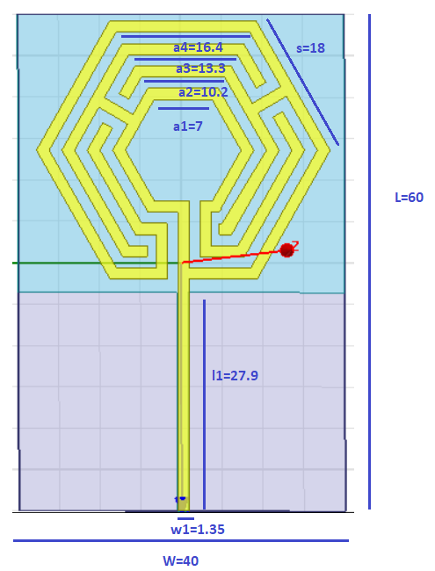
Design values all are in mm

Slide 14
Substrate design -Why Ultralam 3850 ?
Low dielectric constant
Flexible
Polishable to Angstrom level surface finishes
Excellent dimensional stability
Low water absorption
High temperature stability
Excellent machinability
Low outgassing and non-contaminating
Exceptional mechanical strength
Low coefficient of thermal expansion

Slide 15
Performance metrics
Material properties
Gain
Impedance
Radiation pattern

Slide 16
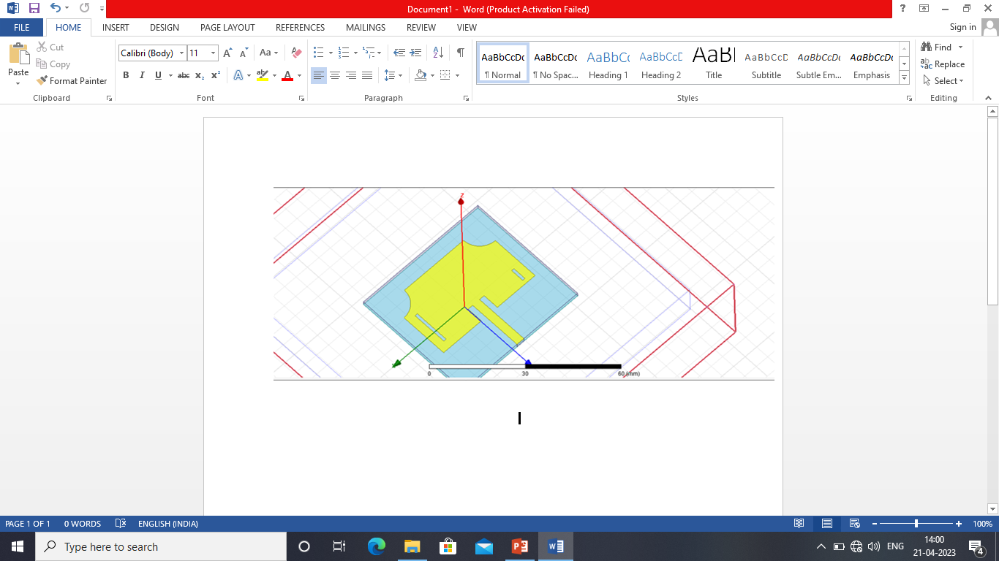
Structure -1

Slide 17
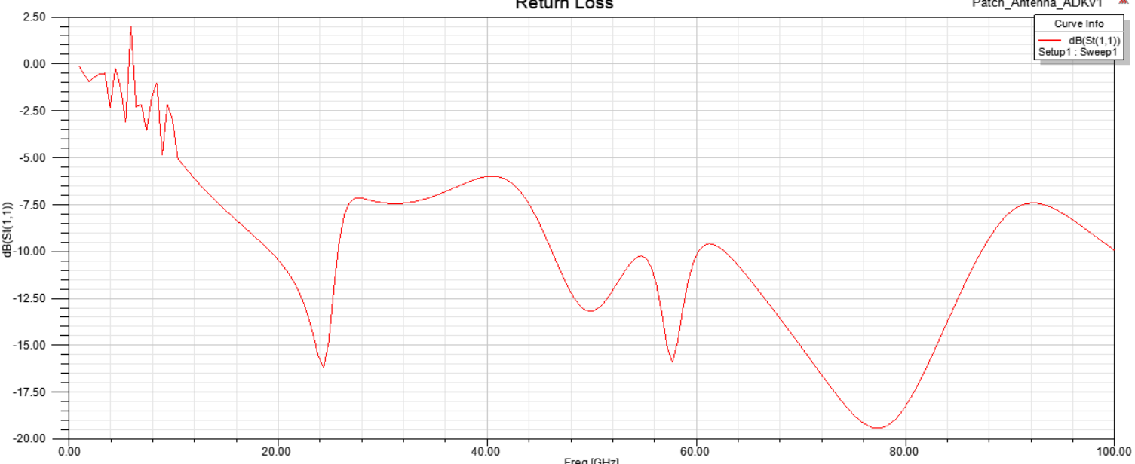
Retrun Loss

Slide 18
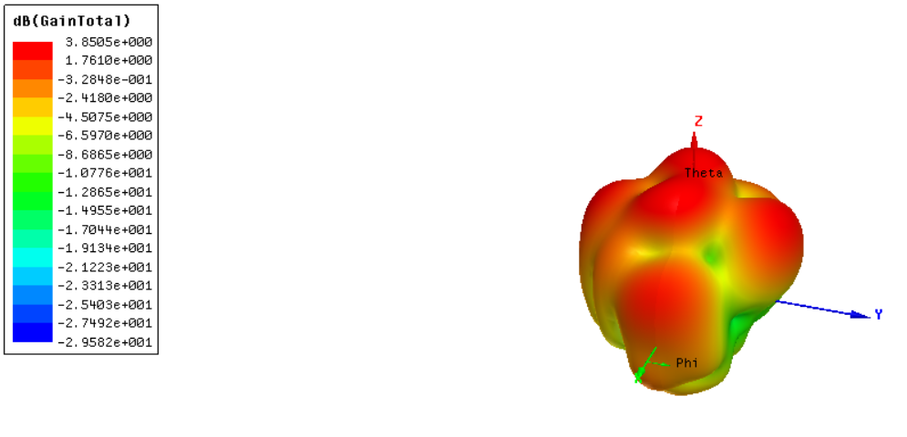
Gain

Slide 19
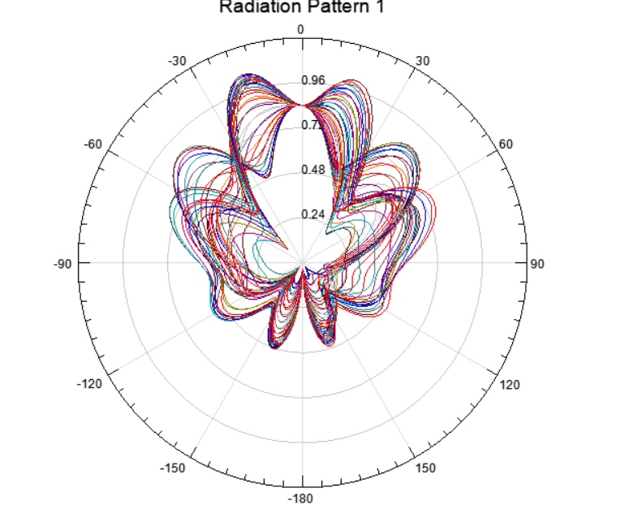
Radiation pattern

Slide 20
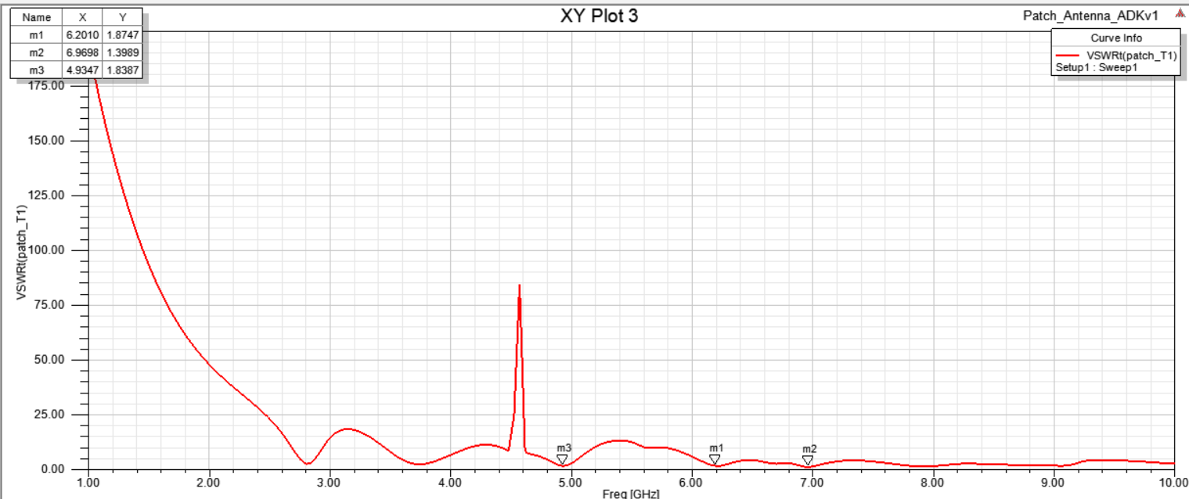
VSWR Measurement

Slide 21
Applications
PCB’s
Device wireless communications

Slide 22
Conclusion
Multiband patch antennas using microstrip inset feed line suitable for 5G applications is elaborated in the work.The antennas proffered are modeled, designed and analyzed in HFSS software.

Slide 23
References
T.S.Rappaport,Y.Xing,G.R.Maccartney,A.F Molisch,e.Mellios,and J.Zhang,”Overview of millimeter wave communication fifth-generation(5G)wireless Network-with a focus on propagationmodels,”IEEETrans.Antennaspropag.,Vol.65,no.12,pp.62136230,dec.2017,doi;10.1109/TAP.2017.2734243.
A.Alomainly.Y.Hao,and F.Pasveer,”Antennas for wearable devices”,in Antennas for portable Devices.Hoboken,NJ,USA:Wiley,2007,pp.3-100.
U. Raque, H. Khalil, and R. S. Ur, ``Dual-band microstrip patch antenna array for 5Gmobile communications,'' presented at the Prog. Electromagn. Res. Symp., Fall (PIERS, FALL), Nov. 2017.
K.-R. Chen, C.-Y.-D. Sim, and J.-S. Row, ``A compact monopole antenn for super wideband applications,'' IEEE Antennas Wireless Propag. Lett.vol. 10, pp. 488491, 2011, doi: 10.1109/LAWP.2011.2157071.

